Slide 1
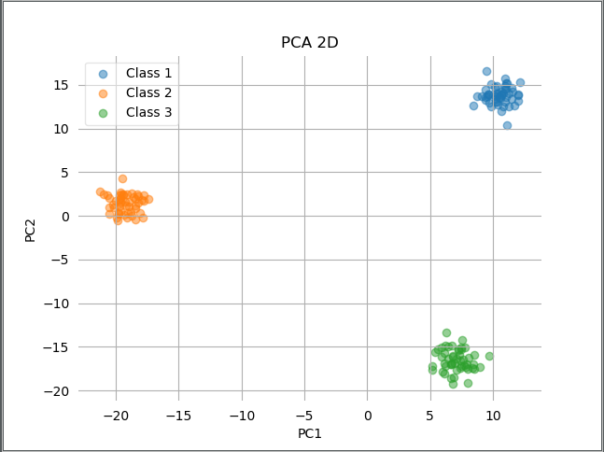
Task 3.3 – Dimensionality reduction – PCA 2D
Normalize the data.
Eigen decomposition(absolute values) for the corresponding covariance matrix – linalg.eigh()
Pick 2 eigenvectors of two largest eigenvalues and project the data.
Error analysis: sum of eigen values thrown away : truncation.
With k=2, at most error 59.3%

Slide 2
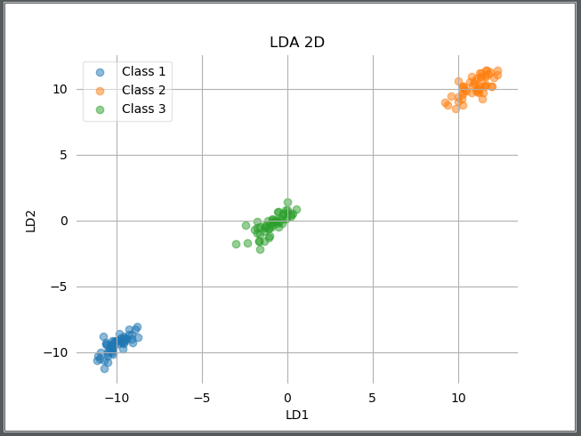
Task 3.3 – Dimensionality reduction – LDA 2D
Compute scatter matrices : mean and variance within and between classes.
Compute projection vector W and eigen do decomposition(absolute values).
Pick 2 eigenvectors of two largest eigenvalues and project the data.
For k=2, at most error 77.5%

Slide 3
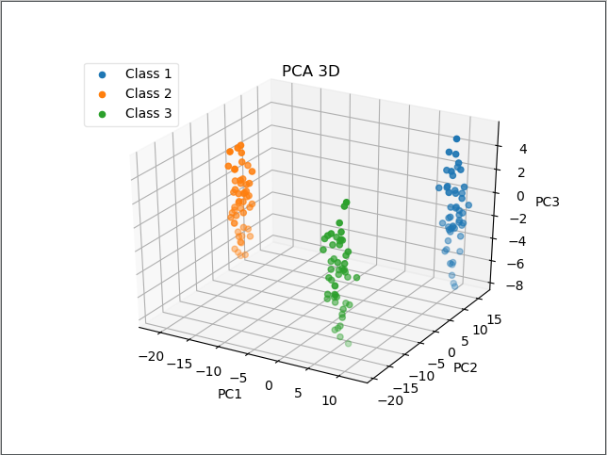
Task 3.3 – Dimensionality reduction – PCA 3D
With k=3, error = 58.3%
General Observations of PCA
Maximum variance for the data.
Good for less samples of data.

Slide 4
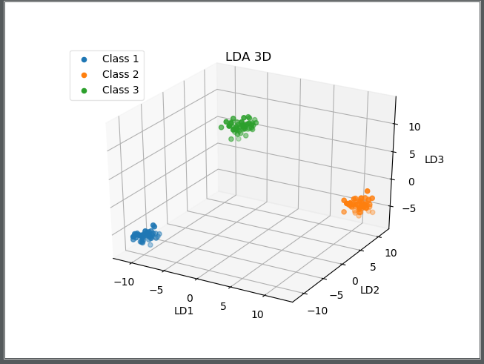
Task 3.3 – Dimensionality reduction – LDA 3D
For k=3, at most error 72.1%
General Observations of LDA
Finds maximum separation between classes and small variance within the class.
Supervised algorithm.

Slide 5
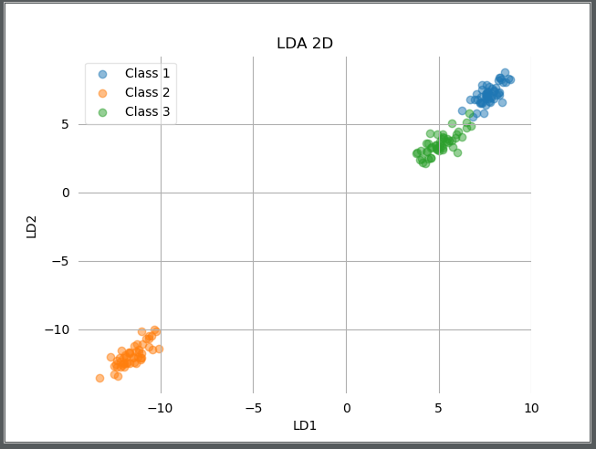
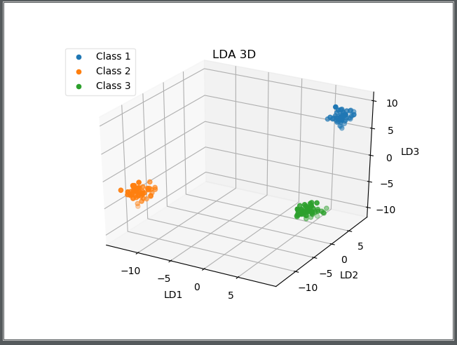
Other plots - using pandas to read the dataset

